Slide 1
Mental Health support
Context
Objective
Trauma - symptoms and behaviour
Trauma-informed practice
What helps? – small group discussion
Activity with a purpose
Engagement – small group discussion
Developing a framework

Slide 2
Trauma – informed Practice
Acknowledge link between trauma and mental health
Adopt broad definition of trauma responses – avoid over medicalisation
Discuss trauma sensitively and understand risks of re-traumatisation
Prioritise trustworthiness and transparency
Approach care through collaboration and partnership
Emphasise strength and coping
Prioritise safety and ensure safe and welcoming environment
Understand and address vicarious trauma by caregivers
Foster community and social networks – link with wider society
Ensure access to evidence-based care, if needed

Slide 3
Activity with a purpose
Education
Volunteering
Creative platform
Explanation and understanding of trauma and its impact (Psychoeducation)
Peer support
Support for children through parents

Slide 4
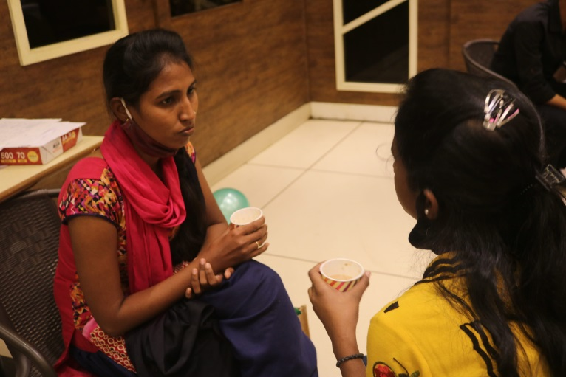
Further support
Steps2 Wellbeing - NHS
BOLOH (‘to speak or to talk’) –Barnardos Helpline
OPTIONS Wellbeing – free initial consultation
For children
ACT (Action for Child Trauma) International
- uses CATT (Children’s Accelerated Trauma Technique)
Bear Us in Mind
- psychological toolkit for use by parents

