Slide 1
Psychological trauma in people seeking asylum and granted leave to remain – developing a trauma-informed approach
Jackie Batchelor
With thanks to Dr Mirjam THulleson

Slide 2
Introduction
The psychological presentation of people granted refuge
An introduction to PTSD and Complex PTSD
Ongoing trauma experience of people seeking asylum
Developing a trauma-informed approach and environment
Vicarious trauma and how we recognise it in ourselves and others

Slide 3
Experiences
I invite you to discuss your experiences with colleagues. There will be small group exercises.
Ground rules:
- Confidential: what is discussed here today stays in the room, unless explicitly agreed otherwise.
- Take a non-judgmental approach.
- Be kind and respectful to yourselves and each other.

Slide 4
What is trauma?
The term trauma originally comes from the Greek word ‘Injury or wound’.
Trauma is much more than a set of symptoms or breakdown in coping.
‘Trauma means a cut into the soul as a result of a horrifying experience’ (Elbert & Schauer, 2002).

Slide 5
What is trauma?
“Trauma is when we have encountered an out-of-control,
frightening experience that has disconnected us from all
sense of resourcefulness or safety or coping or love.”
Tara Brach, 2011

Slide 6
Different kinds of traumatic experiences
One-off trauma: car accident, near drowning, robbery
Sustained long term-trauma: war, imprisonment and torture, trafficking
Trauma in childhood/in the family: sexual abuse, physical abuse, coercive control, domestic violence, severe neglect

Slide 7
Post-traumatic Stress Disorder (PTSD)
The person was exposed to: death, threatened death, actual or threatened serious injury, or actual or threatened sexual violence, in the following way(s):
Direct exposure
Witnessing the trauma
Learning that a relative or close friend was exposed to a trauma
Indirect exposure to aversive details of the trauma, usually in the course of professional duties (e.g., first responders, medics)
(Diagnostic and Statistical Manual of Mental Disorders-5)

Slide 8
PTSD – The four symptom clusters
Altered mood and thinking
Inability to experience happiness or blaming self
Difficulty remembering elements of trauma
Intrusions/Re-experiencing
Flashbacks - Nightmares
PTSD
Alterations in arousal/reactivity
Difficulty sleeping/concentrating, irritation or anger, startle easily
Avoidance
Of trauma related thoughts/ feelings OR reminders of trauma

Slide 9
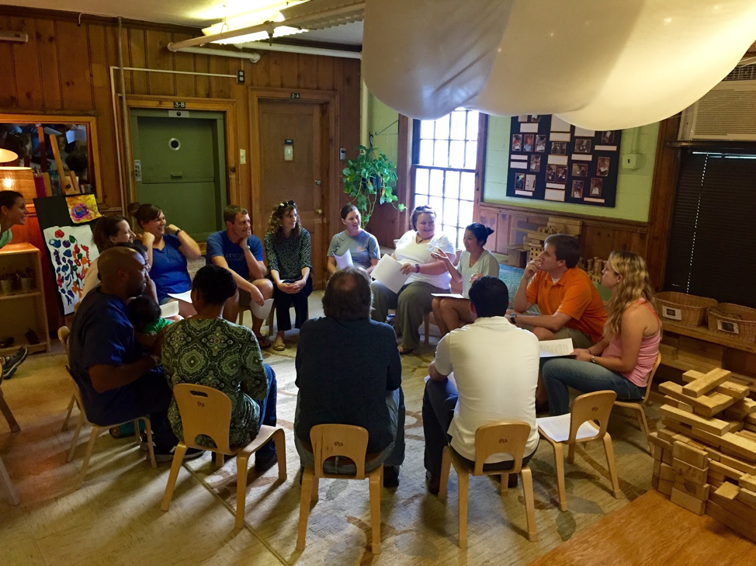
Discussion
What else do you or the people you support struggle with? Reactions, Symptoms, difficulties.
What is missing?
10 minutes

Slide 10
Complex PTSD
‘Complex PTSD develops in a subset of people with PTSD. It is a diagnosis in the ICD‑11, which defines it as arising after exposure to an event or series of events of an extremely threatening or horrific nature, most often prolonged or repetitive events from which escape is difficult or impossible (for example, torture, slavery, genocide campaigns, prolonged domestic violence, repeated childhood sexual or physical abuse). The disorder is characterised by the core symptoms of PTSD; that is, all diagnostic requirements for PTSD are met.’
(ICD-11 is the WHO diagnostic manual)

Slide 11
Complex PTSD manifestation
Difficulty controlling emotions. It's common for someone suffering from C-PTSD to lose control over their emotions, which can manifest as explosive anger, persistent sadness, depression, and suicidal thoughts.
Negative self-view. C-PTSD can cause a person to view themselves in a negative light. They may feel helpless, guilty, or ashamed. They often have a sense of being completely different from other people.
Difficulty with relationships. Relationships may suffer due to difficulties trusting others and a negative self-view. A person with C-PTSD may avoid relationships or develop unhealthy relationships because that is what they knew in the past.
Detachment from the trauma. A person may disconnect from themselves (depersonalisation) and the world around them (derealisation).
Loss of a system of meanings. This can include losing one's core beliefs, values, religious faith, or hope in the world and other people.

Slide 12
Trauma experiences during seeking asylum can be ongoing and complex
Constant uncertainty about safety/status.
Re-traumatization in the host-country i.e., detention, punishing immigration system.
Homelessness.
Vulnerability to exploitation – labour, sexual or physical violence.
Stigma and cultural barriers to seeking help for psychological problems.
Loss and integration challenges: A person has lost their home and all that is familiar, plus loss of loved ones.

Slide 13
What can you do?
Awareness
Develop awareness of how a person’s reactions can be related to PTSD or C-PTSD
Speak
Speak to the people you support about their psychological problems – explain and de-stigmatise traumatic symptoms
Refer
Refer to relevant mental health services in your local area or to their GP
Safety and Empowerment
Establish safety, trust and work from an empowerment perspective

Slide 14
Discussion What do we do in SWVG?
What do we do already?
What more can we do?

Slide 15
A trauma-aware environment
promotes safety and understands that nothing can be achieved until a person feels safe
offers a relational approach to behaviour, that is, behaviour alerts us to the fact that something needs addressing rather than as something that is ‘bad’ and needs punishing
understands our automatic response to stress (fight, flight, freeze) and how to recognise when that is happening and understanding that it is a ‘damaged’ system that needs extra special care if it has been over activated through trauma
nurtures and supports EVERYONE in the environment, recognising that resilient people need resilient others
focuses on our strengths
helps people to regulate their emotions before focusing on anything else
weaves words such as compassion, empathy, connection, safety and trust into its narrative

Slide 16
How can you support yourself when working with survivors of trauma?

Slide 17
Vicarious Trauma
‘The expectation that we can be immersed in suffering and loss and not be touched by it is as unrealistic as expecting to walk through water without getting wet’
Kitchen Table Wisdom: Stories That Heal,
Rachel Remen (1996)
Secondary Traumatic Stress:
‘The natural consequent behaviors resulting from knowledge about a traumatizing event experienced by a significant other. It is the stress resulting from helping or wanting to help a traumatized or suffering person.’
(Figley, 1995).

Slide 18
How does vicarious trauma manifest?
Feeling overwhelmed, exhausted, isolated, low
Feeling disillusioned, despairing and hopeless
Disconnection from loved ones/social withdrawal
Difficulty concentrating
Fight or flight response/heightened arousal
Feelings of anger, sadness, rage
Bystander guilt
Questions of competence/self-worth
Increased sensitivity to violence
Changes in world view / spirituality

Slide 19
Risk factors for developing Vicarious Trauma
Own trauma experiences
Ignoring boundaries/not being able to take space for self
Not taking breaks
Isolation
Not enough reflective space/supervision
Feeling responsibility towards others
Overworking
Poor time management

Slide 20
Important to practise structured self-care
The better you can take care of yourself and maintain healthy boundaries, the more you will be in a position to be truly helpful and compassionate with others who have experienced trauma.

Slide 21
Four steps to structured self-care
Professional supervision and collegial support
Reach out to loved ones and break isolation when impacted by work
Implement your own self-care strategies
Training and development (learn about vicarious trauma)

Slide 22
Discussion
What do you do to keep yourself safe?

