Slide 1
Welcome to Part 1 SWVG Training
This training package should take you about two and a half hours to complete.
This training is for everyone involved in SWVG, whatever role they hope to take. There is further training for those who want to become visitors and teachers.
You will need to have access to the internet to view the linked videos and web pages. It may easiest to put the PowerPoint into slideshow mode, but on slide 29 you will need to press ESC in order to click on the embedded safeguarding documents.
After you have completed the package, we will arrange an online meeting with others to discuss how you found it and how you might become more involved with the charity, and to enable personal contact with SWVG members. As much of the work we do is about the development of personal relationships, we will offer an experiential course in communication when it is possible.

Slide 2
Southampton & Winchester Visitors Group
Aims of the session
To enable you to:
Explain how SWVG started and how we work together with people who are seeking asylum.
Discuss why people seek sanctuary and some of the needs of people seeking asylum.
Explain the current environment and national situation for people seeking asylum.
Describe information about each of the SWVG groups.
Explore aspects of safeguarding and read our SWVG policy.
Be aware of the SWVG further Training and Support Programme for potential visitors and teachers.
Hyperlinks are in blue and underlined. There are also Questions in blue.

Slide 3
Please click on the links in paragraphs below and read the material on the website.
The first aim is to understand a little of the history of SWVG, its ethos and work.
SWVG members believe in justice and fairness, and that all people seeking asylum have the right to respect and compassion; SWVG works in a collegiate way; among SWVG members there is a high level of trust; we always embrace change; SWVG works closely with other organisations; we aspire always to improve and develop both ourselves and SWVG as an organisation.
SWVG is also involved in advocacy and campaigning. There are about 200 people seeking asylum in Southampton and a few Syrian refugees in Winchester. SWVG works with some of them by providing visitors, English teachers, some financial support, a drop-in centre at the Avenue Multicultural Centre, and a hostel that can house up to six destitute people seeking asylum.

Slide 4
SWVG works co-operatively with other local asylum charities such as the CLEAR project, Southampton Action and the British Red Cross. An important feature of SWVG is that we work, in the main, through a long-term relationship to support people who are seeking asylum.
We have a team of visitors and English teachers who work with clients. Please read here to find more about being a visitor and volunteering, and here for the other ways you might help.

Slide 5
Some facts and figures: how much do you know about SWVG?
When did people first get together to help the Kurds?
1979
1989
1999
When did they first work with asylum seekers?
1992
1989
2001

Slide 6
Some facts and figures: how much do you know about SWVG?
When did people first get together to help the Kurds?
1989
When did they first work with asylum seekers?
1992
1989
2001

Slide 7
Some facts and figures: how much do you know about SWVG?
When did people first get together to help the Kurds?
1989
When did they first work with asylum seekers?
2001

Slide 8
Some facts and figures: how much do you know about SWVG?
That’s right.
SWVG has nearly 20 years of experience with the asylum system.

Slide 9
Some facts and figures:
Southampton and asylum seekers
How many asylum seekers are there in Southampton?
20
200
2000
How many people live in Southampton?
256,459
25,645
2,564,975

Slide 10
Some facts and figures:
Southampton and asylum seekers
How many asylum seekers are there in Southampton?
200
How many people live in Southampton?
256,459
24,275
2,545,275

Slide 11
Some facts and figures:
Southampton and asylum seekers
How many asylum seekers are there in Southampton?
200
How many people live in Southampton?
256,459

Slide 12
Some facts and figures:
Southampton and asylum seekers
Southampton (population 256,459) is host to about 200 people seeking asylum.
People seeking asylum represent just 0.08% of the population!
Do you think we are being overrun?

Slide 13
What does SWVG provide?
A hostel for up to six people
Trained volunteers
Expenditure on legal-related activities
Funds for housing and subsistence
A food bank
Events and outings

Slide 14
What does SWVG provide?
A hostel for up to six people
Trained volunteers
Expenditure on legal-related activities
Funds for housing and subsistence
A food bank
Events and outings

Slide 15
What does SWVG provide?
A hostel for up to six people
Trained volunteers
Expenditure on legal-related activities
Funds for housing and subsistence
A food bank
Events and outings

Slide 16
What does SWVG provide?
A hostel for up to six people
Trained volunteers
Expenditure on legal-related activities
Funds for housing and subsistence
A food bank
Events and outings

Slide 17
What does SWVG provide?
A hostel for up to six people
Trained volunteers
Expenditure on legal-related activities
Funds for housing and subsistence
A food bank
Events and outings

Slide 18
What does SWVG provide?
A hostel for up to six people
Trained volunteers
Expenditure on legal-related activities
Funds for housing and subsistence
A food bank
Events and outings

Slide 19
What does SWVG provide?
A hostel for up to six people
Trained volunteers
Expenditure on legal-related activities
Funds for housing and subsistence
A food bank
Events and outings

Slide 20
Being a member:
Which of the groups below can you join as a member of SWVG?
Trustees with overall responsibility for our work and finances
Communications Group
Activities Group
Campaigning Group
Fundraising Group
Events Groups
Motorcycle maintenance
Training Group
English teachers

Slide 21
Being a member:
Which of the groups below can you join as a member of SWVG?
Trustees with overall responsibility for our work and finances
Communications Group
Activities Group
Campaigning Group
Fundraising Group
Events Groups
Motorcycle maintenance
Training Group
English teachers

Slide 22
Being a member:
What do you need to be able to give as a visitor? (Hint: it’s not money….)

Slide 23
Being a member:
What do you need to be able to give as a visitor? (Hint: it’s not money….)
Time
Qualities
Skills

Slide 24
Being a member:
What do you need to be able to give as a visitor? (Hint: it’s not money….)
Time
About an hour a week with the client, plus time for preparation, follow-up, seeking advice and support meetings – usually about 4 hours a week

Slide 25
Being a member:
What do you need to be able to give as a visitor? (Hint: it’s not money….)
Time
About an hour a week with the client, plus time for preparation, follow-up, seeking advice and support meetings – usually about 4 hours a week
Qualities
A degree of emotional resilience
Ability to be a member of a team and also to work on your own initiative
Skills

Slide 26
Being a member:
What do you need to be able to give as a visitor? (Hint: it’s not money….)
Time
About an hour a week with the client, plus time for preparation, follow-up, seeking advice and support meetings – usually about 4 hours a week
Qualities
A degree of emotional resilience
Ability to be a member of a team and also to work on your own initiative
Skills
Good communication and listening skills, being a facilitator
Practical problem-solving skills
The ability to maintain confidentiality

Slide 27
Being a member:
You are not alone as a member - SWVG has a comprehensive support mechanism
Training
Comprehensive initial training plus a handbook and website material for reference
Opportunities for ongoing training and to attend conferences as required
Back up
Support and advice from the Co-ordinators and from an experienced colleague who acts as mentor and backup visitor
Group support
Regular visitors’ support meetings for problem-solving and sharing knowledge and experiences
General member meetings on topical issues every two months

Slide 28
Members are able to contribute to SWVG in a variety of capacities including fundraising, campaigning, communications.
COORDINATING TEAM Money Allocation Group (MAG) Non-Assist Monitoring (NAM) Avenue Multicultural Centre (AMC)
Claudia Glyn 01420 513214 claudia.glyn@swvg-refugees.org.uk
Catherine Hartley 07500 007771 catherine.hartley@swvg-refugees.org.uk
Xanthe Hackett 02380 226948 swvg.admin@gmail.com
TRUSTEE BOARD
Mark Courtice 01590 645660 mark.courtice@swvg-refugees.org.uk
COMMUNICATIONS digital and print
Chris Holloway 07779 283451 Chris.holloway@swvg-refugees.org.uk
OUTREACH
Stash Kozlowski
07902 857241
stash.kozlowski@swvg-refugees.org.uk
CAMPAIGNS
William Brook-Hart william.brook-hart@swvg-refugees.org.uk
SWVG Group Contacts
SUPPORT GROUPS
Jackie Batchelor 01489 891724 jackie.batchelor@swvg-refugees.org.uk
FUNDRAISING
Sue Turner sueturner7@googlemail.com Hazel Inskip hazel.inskip@gmail.com
MEMBER TRAINING
Jackie Batchelor 01489 891724 jackie.batchelor@swvg-refugees.org.uk
ACTIVITIES FOR PEOPLE SEEKING ASYLUM
Sue Jessup smjessup01@gmail.com
WINCHESTER EVENTS
Anne Leeming 01962 866215 anneleeming31@btinternet.com
SOUTHAMPTON EVENTS
vacancy
TEACHING
Catherine Hartley 07500 007771 Catherine.Hartley@swvg-refugees.org.uk
See page D1 of folder Jan 2022

Slide 29
Safeguarding 1
Safeguarding is everyone’s duty, and the safety and welfare of our clients is paramount in all that we do. Each of us has a role to play in keeping our clients and ourselves safe, and passing on any concerns that we may have. It’s been well documented that new migrants, people seeking asylum and those recently granted leave to remain are in the highest category of those who might be at risk. SWVG is required by the Charities Commission to ensure that all volunteers, whatever their remit, are fully up to date with safeguarding and are of aware of possible signs of various types of abuse.
SWVG has a robust safeguarding policy which you can read here:
together with an incident reporting form. All volunteers must be familiar with these.
Please also read the Southampton City training sheet summary:
To access the two documents, exit the slide show and click on the icons.

Slide 30
Safeguarding 2
Recognising signs that radicalisation may be taking place is an important part of safeguarding, and there is a link to the Southampton City Council e-learning module entitled Raising Awareness of Prevent.
Please complete the e-learning module. We can assure you it’s not too onerous, but be aware that if you have a concern, then SWVG's safeguarding lead should be contacted (not the council’s). There is a longer (40 min) government interactive training which is interesting, and you may also want to explore it.
Should you have any concerns about safeguarding please do not hesitate to email our safeguarding lead: david.retter@swvg-refugees.org.uk

Slide 31
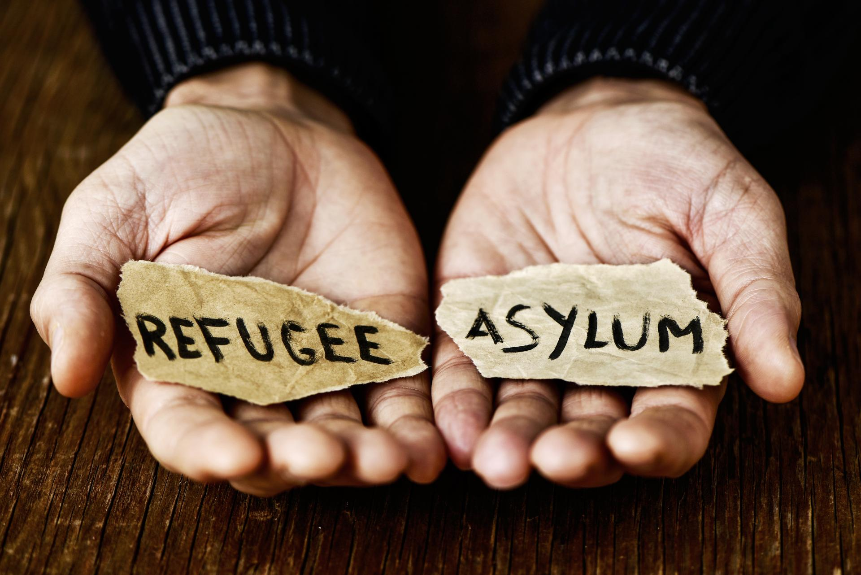
Asylum and Refugees
The following pages give some information and definitions of refugees and asylum seekers.
Before you start, what do you think is the difference?

Slide 32
Asylum and Refugees
The following pages give some information and definitions of refugees and asylum seekers.
Before you start what do you think is the difference?
The UNHCR web site provides us with a good picture of the global situation. Please explore it a little.

Slide 33
Asylum and Refugees
According to the UNHCR…
How many people are forcibly displaced in the world?
82.4 million
8.2 million
82 thousand
5.7 million

Slide 34
Asylum and Refugees
According to the UNHCR…
How many people are forcibly displaced in the world?
82.4 million
Which are the top three countries from which refugees come?
Syria
South Sudan
Iraq
Syria
Iraq
Myanmar
Syria
Venezuela
Afghanistan

Slide 35
Asylum and Refugees
According to the UNHCR…
How many people are forcibly displaced in the world?
79.5 million
Which are the top three countries from which refugees come?
Syria 6.7m
Venezuela 4.0m
Afghanistan 2.6m

Slide 36
Asylum and Refugees
Please view this short TEDEd video giving an overview of refugees and asylum seekers..

Slide 37
Definitions:
A refugee is someone who has had to leave his/her country and who is afraid to return there 'owing to a well-founded fear of being persecuted for reasons of race, religion, nationality, membership of a particular social group or political opinion’
(1951 UN Convention Relating to the Status of Refugees)
An asylum seeker is a person who has crossed an international border and is seeking safety or protection in another country. In the UK, asylum seekers are refugees who have claimed asylum and are awaiting a Home Office decision as to whether they can stay here.
A person granted Leave to Remain in the UK by the Home Office may be given refugee status or humanitarian protection.

Slide 38
Myth
They have no right to be here.
Fact
The UK signed the 1951 Convention of Refugees - anyone has the legal right to come here, apply for asylum and remain in the UK until a final decision is made on his or her asylum application.

Slide 39
Myth
They are illegal.
Fact
There is no such thing as an illegal asylum seeker. Entry using false document is recognised as the only way many people can reach a safe country.

Slide 40
This section tells you more of how people become displaced and what they might expect on arriving in the UK.
Please make some notes on what you think and feel about each video.
Please view this 15 minute video of a Syrian family's refugee journey.
Please view this 5 minute video about claiming asylum in the UK
Please watch this 5 minute video about the initial screening interview

Slide 41
Watch this video that discusses how hard it is to get Right to Remain.
The Right to Remain Toolkit is a very useful resource to support people seeking asylum.
The life of people seeking asylum was very hard under the hostile environment phase.
This clip shows a little of life for a person seeking asylum. The funding has increased a little since it was made, to about £38 per week.

Slide 42
Further training
The further training for visitors and teachers explores some of these issues in more detail, and outlines the support, via backups and support groups, that SWVG provides. There will also be a chance to meet an asylum seeker and a current visitor, to ask questions, and to visit AMC if you have not already done so.
There is also a session on listening and communication skills, and a final session, when you have been in your role for maybe six months, to reflect on how it is going.
All SWVG members undertake ongoing training and development.

Slide 43
Thank you for completing this programme. Congratulations!
We hope you are now able to:
Explain how SWVG started and how we work together with people who are seeking asylum.
Discuss why people seek sanctuary and some of the needs of people seeking asylum.
Explain the current environment and national situation for people seeking asylum.
Find information about each of the SWVG groups.
Discuss aspects of safeguarding and be aware of our SWVG policy.
Describe the SWVG Training and Support Programme for potential visitors and teachers.
Having explored these subjects, please write down a few of your thoughts about asylum and how you might like to work with SWVG.

Slide 44
Next steps
If you haven’t already volunteered to work with SWVG, and would like to do so, please complete an application form and send it to Jessica at jessica.hasan@swvg-refugees.org.uk
A short online discussion will be arranged with other potential members, to explore what you have learnt.
Please email info@swvg-refugees.org.uk to let us know you have completed the training, and when we have a small group, we will arrange the online discussion.

